Slide 1
Component Configurator
Guilherme Kelly
Henrique Borges
Igor Marques

Slide 2
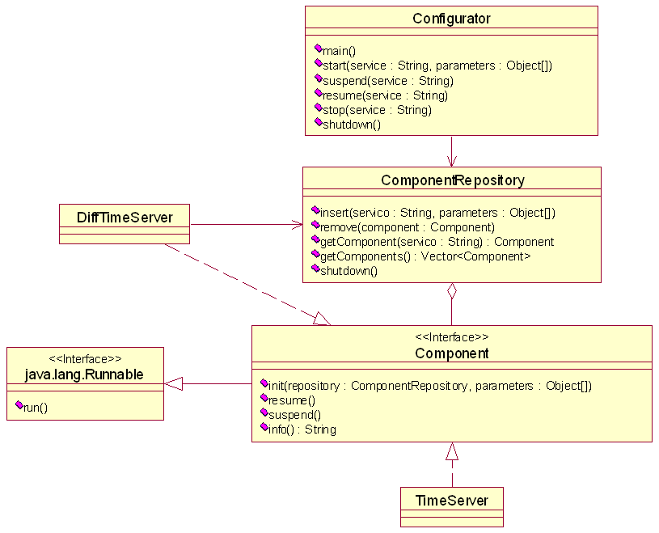
Diagrama de Classes

Slide 3
Inicializando componentes
----------------------------------------------------------
IF749 - Exercicio 3
----------------------------------------------------------
start [SERVICE NAME] [PARAM1] [PARAM2]...
resume [SERVICE NAME]
suspend [SERVICE NAME]
stop [SERVICE NAME]
list
exit
----------------------------------------------------------
>start exercicio3.TimeServer 6544
Starting exercicio3.TimeServer...OK

Slide 4
Suspendendo e reiniciando componentes
>suspend exercicio3.TimeServer
Suspending exercicio3.TimeServer...OK
>resume exercicio3.TimeServer
Resuming exercicio3.TimeServer...OK

Slide 5
Parando components
>list
1 component(s) running.
Name: exercicio3.TimeServer
Info: [Running] TimeServer (port 6544)
>stop exercicio3.TimeServer
Stopping exercicio3.TimeServer...OK
>list
0 component(s) running.

Slide 6
Componentes com dependências
public class DiffTimeServer implements Component {
(...)
private TimeServer getTimeServer() {
return ((TimeServer) componentRepository .getComponent("exercicio3.TimeServer"));
}
protected String getMessage() {
long temp = lastTime;
TimeServer timeServer = getTimeServer();
if (timeServer == null) {
return "Cannot locate a required component: \"exercicio3.TimeServer\"";
} else {
lastTime = timeServer.getTime();
return Long.toString(lastTime - temp);
}
}

Slide 7
Dúvidas? Sugestões?

